Slide 1
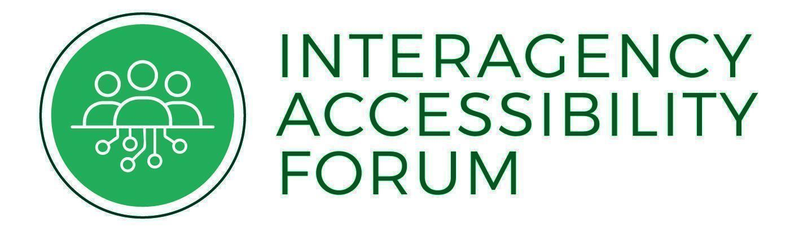
Efficiently Procure, Build, & Deploy Accessible Self-Service Kiosks
Presented by: Laura Boniello Miller
May 21, 2025

Slide 2







Agenda
What accessibility-related laws and standards apply to kiosks/SSTMs?
What is a kiosk?
What are Section 508 Requirements for an accessible kiosk?
Kiosks in the federal space
Assessment Results: 2023 (Kiosk)
SSA Kiosk
Next Steps
Notes:
Examples include computers, telecommunications equipment, multifunction office machines such as copiers that also operate as printers, software, websites, information kiosks and transaction machines, and electronic documents. The Section 508 Standards, which are part of the Federal Acquisition Regulation, ensure access for people with physical, sensory, or cognitive disabilities. Included in the list, something that is often lost in the abyss between hardware teams and software teams, information kiosks and transaction machines.
How many of your agencies or components have purchased or otherwise acquired self service kiosks?
Question: Are kiosks software or hardware?
In your experience, who is responsible for ensuring a kiosk is Section 508 compliant?

Slide 3
Accessible Kiosks in Government
Updated in 2017, the Revised Section 508 of the Rehabilitation Act requires that ICT is accessibly developed, procured, maintained and used by federal agencies.
Other Applicable Fed Gov Laws:
The Air Carrier Access Act (ACAA)
Voluntary Voting System Guidelines (VVSG), Help America Vote Act (HAVA)
Notes:
Examples include computers, telecommunications equipment, multifunction office machines such as copiers that also operate as printers, software, websites, information kiosks and transaction machines, and electronic documents. The Section 508 Standards, which are part of the Federal Acquisition Regulation, ensure access for people with physical, sensory, or cognitive disabilities. Included in the list, something that is often lost in the abyss between hardware teams and software teams, information kiosks and transaction machines.
How many of your agencies or components have purchased or otherwise acquired self service kiosks?
Question: Are kiosks software or hardware?
In your experience, who is responsible for ensuring a kiosk is Section 508 compliant?

Slide 4
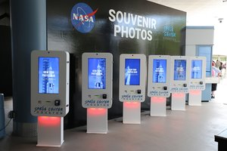
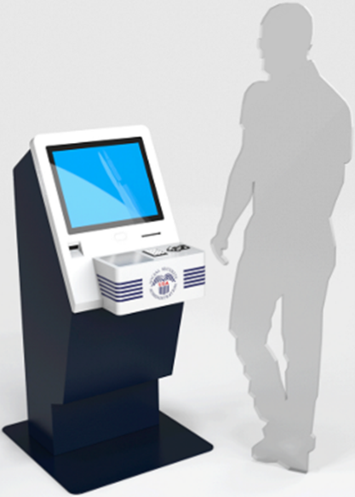
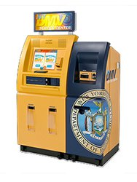
What is a kiosk?
A kiosk is a stand-alone device that is typically interactive and used to facilitate automated tasks such as ticket purchasing, checkout, self ordering, and more.

Slide 5
Accessibility Requirements
What are Section 508 Requirements for a Kiosk?
Closed Functionality
If users can not install assistive technology, it must be provided. (402)
Software
Software must interoperate with assistive technology. (502)
Operable Parts
Hardware must meet height and reach requirements, tactile input device, braille, etc. (407)
Notes:
Does the system prevent users from installing their own assistive technology? (402)
Describe 502. Also read from 402 and 407. And then add the other exceptions and examples (biometrics etc to show complexity). Don’t go into detail.

Slide 6
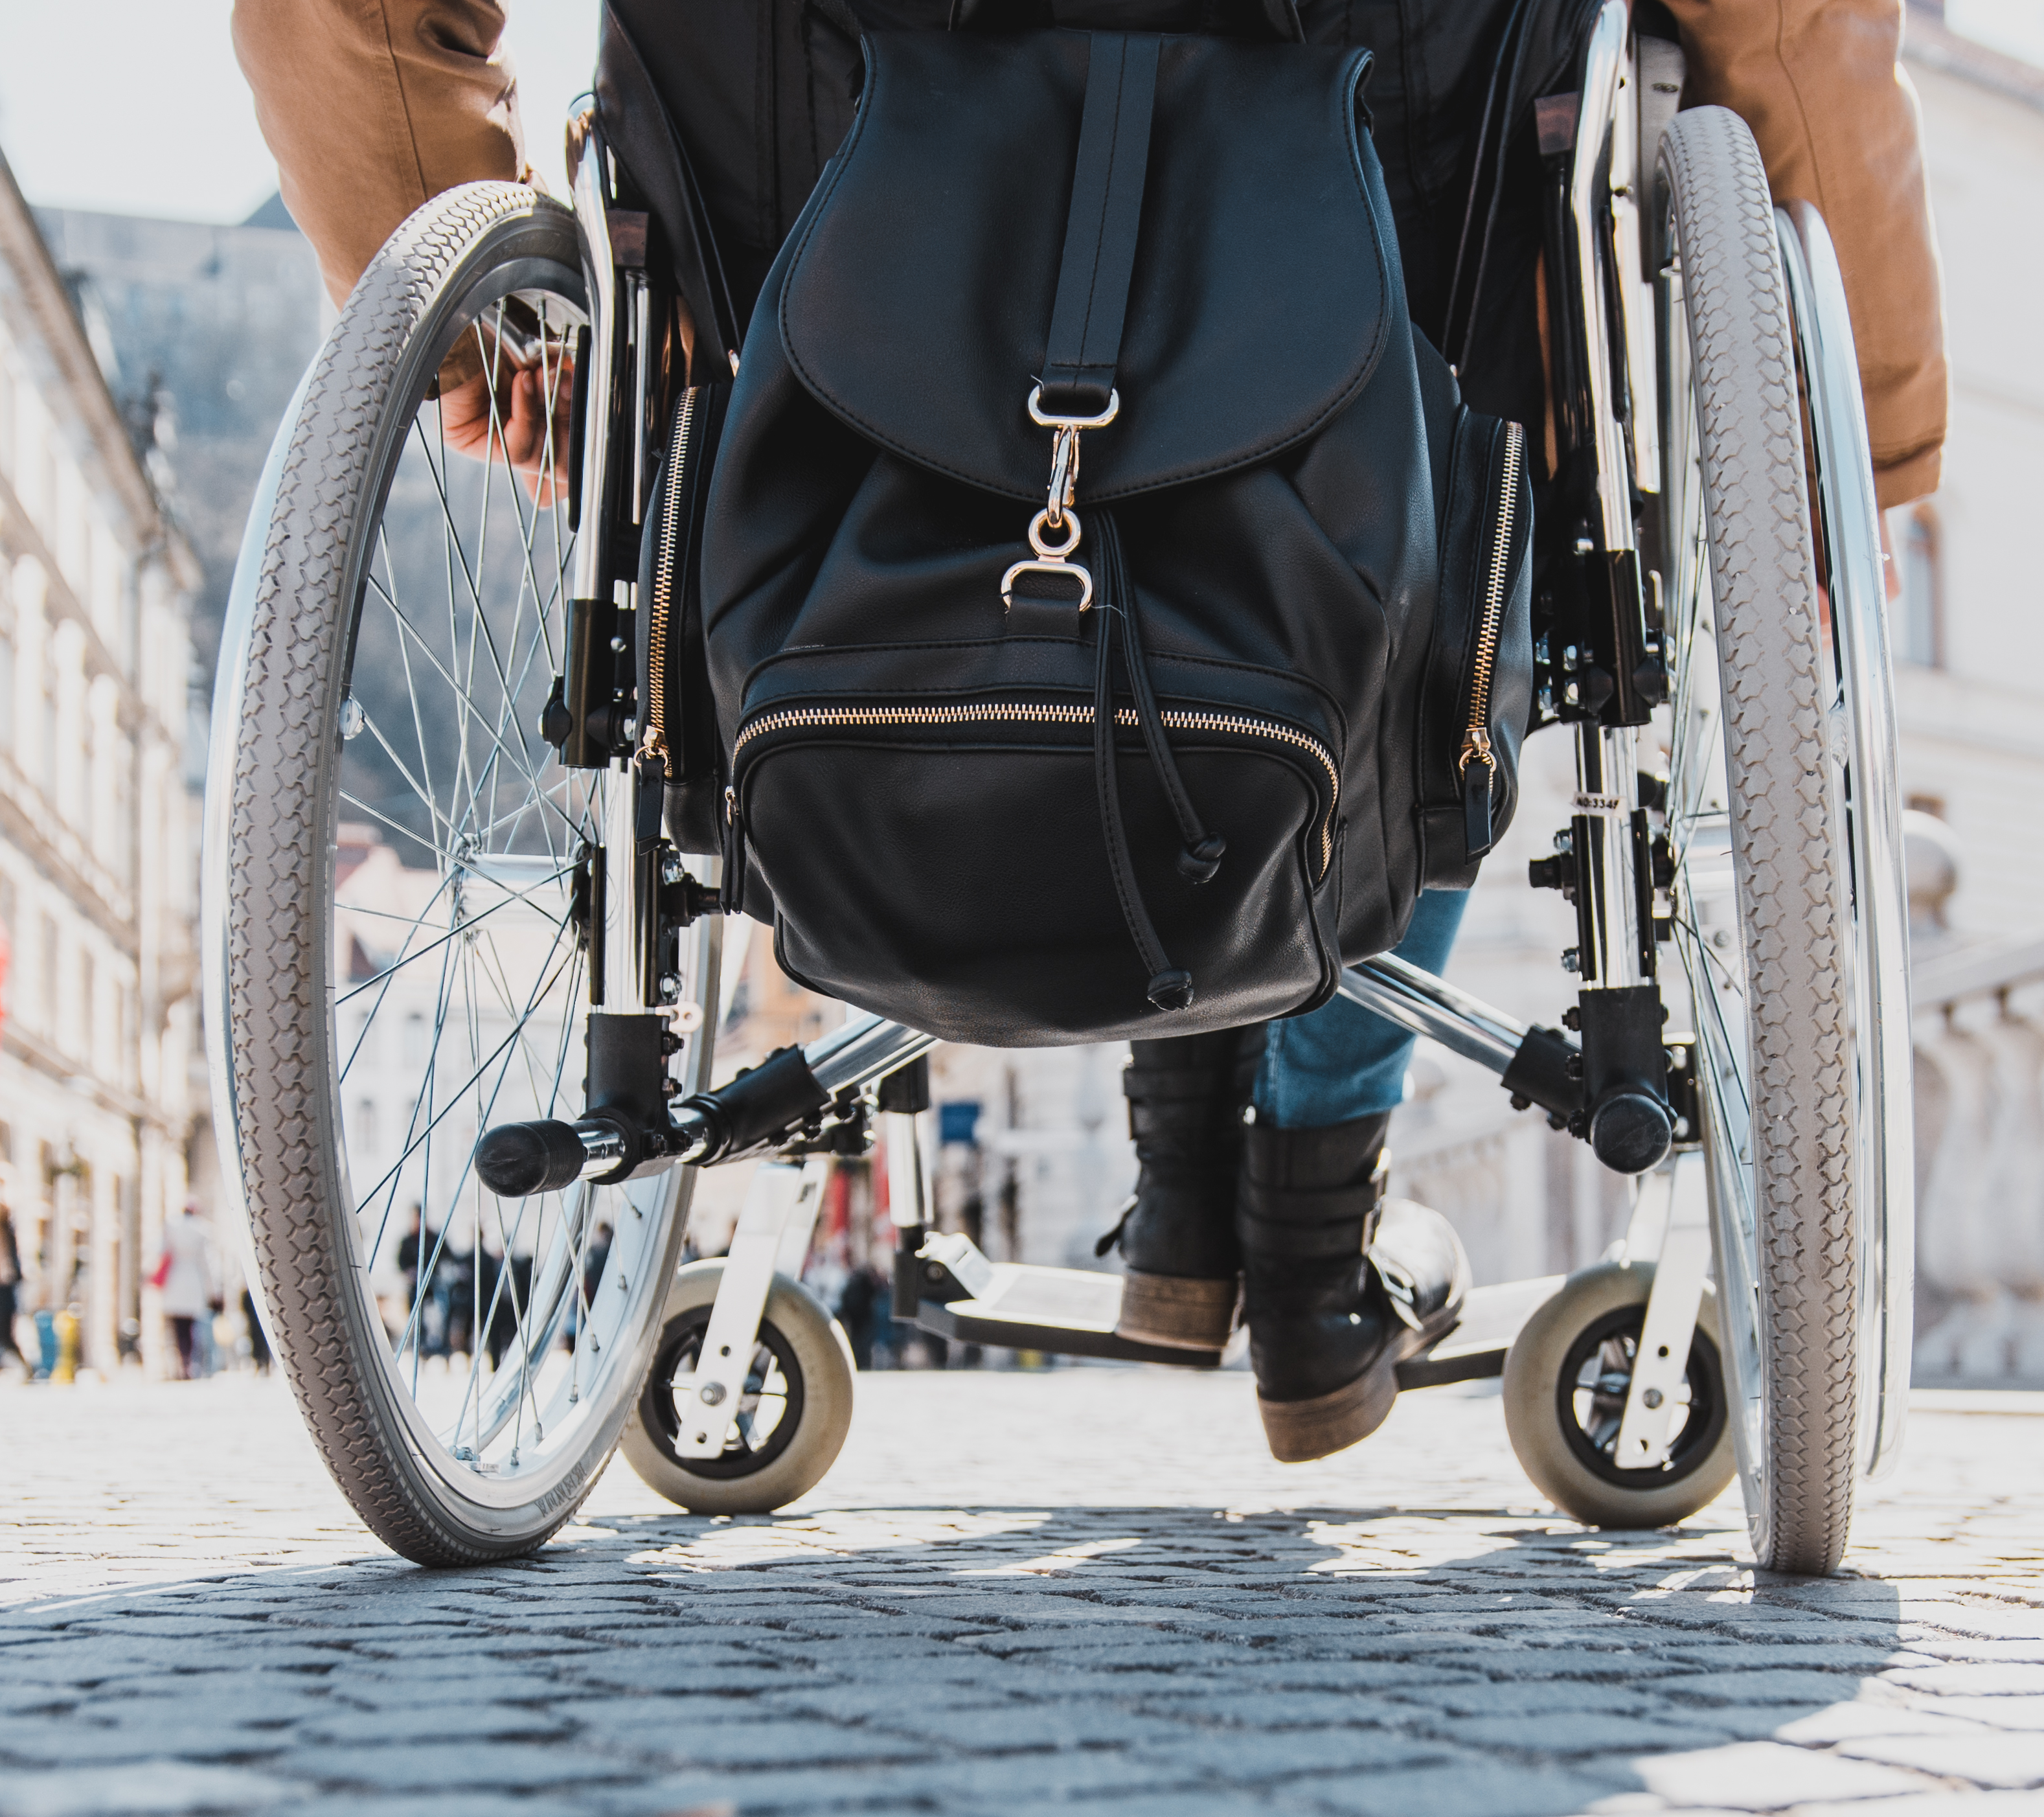
Usable Kiosks
Functional performance criteria (302)
Without vision
With limited vision
Without perception of color
Without hearing
With limited hearing
Without speech
With limited manipulation
With limited reach and strength
With limited language, cognitive, and learning abilities
Notes:
Does the system prevent users from installing their own assistive technology? (402)
Describe 502. Also read from 402 and 407. And then add the other exceptions and examples (biometrics etc to show complexity). Don’t go into detail.

Slide 7
Kiosk questions asked in 2023 Annual Assessment
Do you have any kiosks that are used by the public?
Do your agency’s kiosks fully conform to all applicable Section 508 standards?
Yes, Fully Conforms
11
Yes, but only some fully conforms
8
No, Does not fully conform
5
Unknown if fully conforms
62
Yes 86
N/A
163

Slide 8
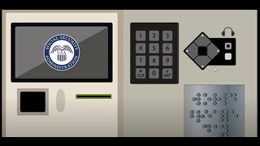
Video
SSA VIPr Kiosk: Accessible Check-in Video
Notes:
SSA VIPr Kiosk: Accessible Check-in Video: https://youtu.be/m_U_swyxZuw?si=lieelsWMaUHJnPqY

Slide 9

Example: Social Security Installs Accessible Check in Kiosks 1/2
Key Features
Accessible keypads
Audio headphone jacks with complimentary, single-use headphones available on request.
Braille instructions for how to use the kiosk, including how to report any accessibility issues.
Touch-screen monitors with privacy filters.
Built-in thermal printers and ticket dispensers.
Enhanced 508-compatible check-in software.
Physical case/cabinet meeting specific height and width requirements.

Slide 10

Example: Social Security Installs Accessible Check in Kiosks 2/2
2017
2020
2021-2023
2017 lawsuit against SSA filed by National Federation of the Blind
2020 settlement agreement - SSA agreed to improve the VIPr kiosks to ensure accessibility for blind users
-Touchscreens, visual displays required sighted individuals to assist blind users
- Privacy impact
2021-2023 New kiosk solicitation released, awarded, developed, and deployed
-SSA publicly available checklist
https://www.ssa.gov/accessibility/testmethod.html?tab=1
From inaccessible to accessible
Notes:
SSA publicly available checklist: https://www.ssa.gov/accessibility/testmethod.html?tab=1

Slide 11
Next Steps
GSA Next Steps: Hardware Baseline Development and Release in late 2025/ early 2026
The Access Board and GSA are working together to create a baseline test for hardware testing processes. Much like the web baseline and documents baseline, the hardware baseline will describe what to evaluate to determine conformance to the Revised 508 Standards.
Section 508 PMs and Others: Research internally if you have kiosks
In the assessment from 2023, there were 35% of respondents that said their organization has kiosks used by the public.
In 2024’s assessment, 12.2% of respondents use a kiosk test process. (30)

Slide 12
Next Steps, cont'd
For all agencies: Procure accessible kiosks
Is your agency or organization likely to procure self service kiosks?
Do you know how to incorporate Section 508 into your kiosk procurement process?
Recommendations:
Use ART - Section 508 requirements language in the RFP
Include detailed specifications for accessibility
Require verification through (PwD) user testing in pilot/before mass production
Include consequences (financial and remediation) if not accessible
Create a hardware testing process for internal testing throughout the procurement, design, development, and deployment process. See SSA Kiosk Testing process example.

Slide 13

Questions?

Slide 14

Thank you!
Laura.b.miller@gsa.gov Section.508@gsa.gov
Notes:
Laura.b.miller@gsa.gov Section.508@gsa.gov

